Slide 1



Team 12
TechClub AI
The Collaborative Learning Orchestrator
Automating peer learning with AI and GitHub.
Ayush Kumar Gupta
Namrata Vijay Mali
Sai Mani Ritish Upadhayula
Divakar Reddy Ravi
Project lead and coordinator
Design and UX specialist
Backend developer
QA and testing lead

Slide 2

The Problem: Managing Peer Learning is Hard
Inefficient Grouping
Skill Mismatch
Manual student grouping is time-consuming and often inefficient, leading to suboptimal team dynamics and wasted effort.
It's challenging to match complementary skills, such as pairing a frontend developer with a backend expert, hindering effective collaboration.
Messy Progress Tracking
Lack of Direction
Tracking progress across multiple diverse teams becomes a complex and disorganized task, obscuring overall project status.
Students frequently struggle with a lack of realistic project ideas and structured roadmaps, impeding their learning and development.

Slide 3
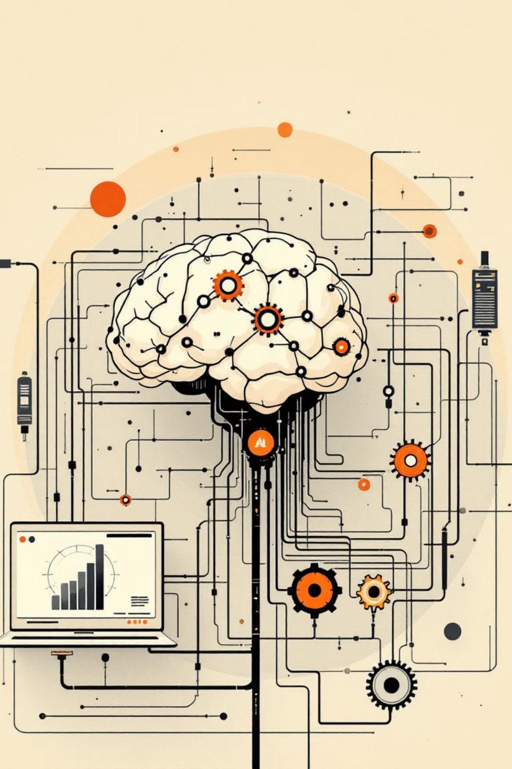




The Solution: TechClub AI
An AI-powered ecosystem that automates the entire lifecycle of a tech club, from onboarding to project completion.
Profile
Smart ingestion of student skills and interests, creating comprehensive individual profiles.
Match
AI forms balanced, high-performing teams optimized for collaboration and learning.
Build
Automated generation of detailed project scopes and pre-configured GitHub repositories.
Track
Real-time progress tracking and performance monitoring via seamless GitHub Webhooks integration.

Slide 4

Feature 1: The Growth Card (Smart Profiling)
Dynamic Data Capture
Our intuitive forms dynamically capture essential user data including Name, Degree, Major, and Experience.
Intelligent Intent Analysis
Natural Language Processing (NLP) parses free-text "Project Ideas" to deeply understand user intent and aspirations.
Personalized Growth Path
Generates a visual "Growth Card" for every member, clearly highlighting domains to explore and showcasing their current strengths.

Slide 5

Feature 2: AI Team Formation & Project Genesis
Intelligent Matching
AI expertly pairs learners with seasoned experts, fostering a mentorship model and aligning shared interests for optimal team synergy.
Instant Setup
The system automatically creates a dedicated GitHub Repository, writes a comprehensive README.md file, and generates a detailed Task List (GitHub Issues) tailored to the team's combined skill level.

Slide 6
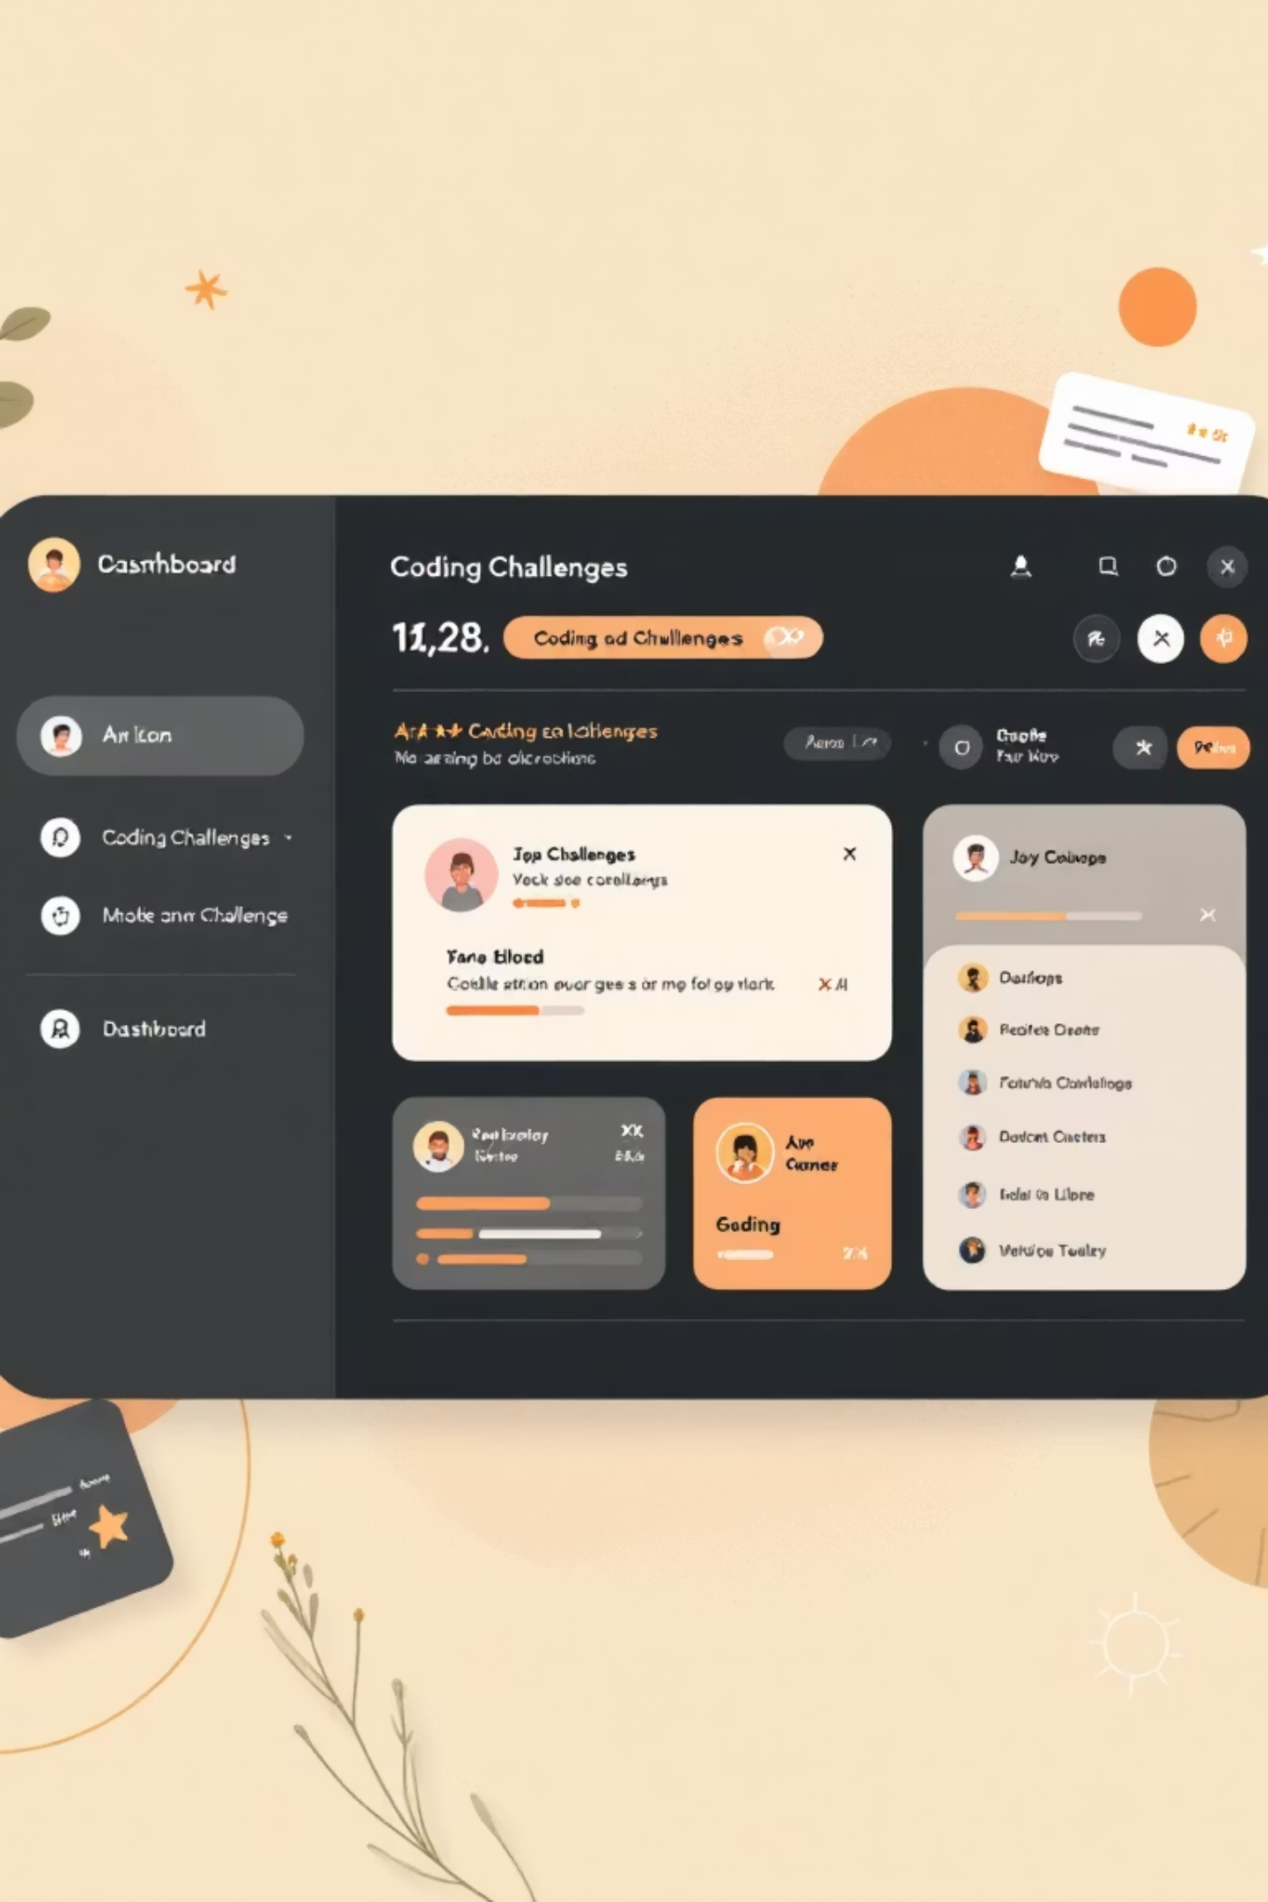
Feature 3: The Progress Engine
Seamless Workflow
Members efficiently claim GitHub Issues and submit Pull Requests (PRs), streamlining the development process.
Real-time Automation
Our system intelligently listens for PR merges, automatically marking tasks as "Complete" on the centralized dashboard.
Engaging Gamification
Members earn valuable XP and exclusive "Badges" for their code contributions, visualizing their momentum directly on their personalized Growth Card.

Slide 7
Technical Architecture: The Stack
Built with cutting-edge technologies to ensure performance, scalability, and an engaging user experience.
Frontend: Next.js 14
Backend: FastAPI
Database: MongoDB
Leveraging React for a dynamic and responsive user interface with a distinctive Cyber/Synthwave aesthetic.
Python-based for high-performance asynchronous processing, ensuring rapid and efficient data handling.
A flexible NoSQL database ideal for efficient storage and retrieval of diverse JSON-formatted user profiles.
AI Engine: OpenAI GPT-4
Integration: GitHub API
Seamless integration with GitHub REST API & Webhooks for project management and real-time updates.
Powering intelligent logic, sophisticated text generation, and dynamic content creation.

Slide 8

How It Works: The Data Flow
Submission
Matching
User profile is sent to the Database.
Admin triggers AI to group users and create Project.
Development
Delivery
System pushes code to GitHub and creates Issues.
Team merges PRs; Webhook updates Dashboard; AI suggests next steps.

Slide 9

Summary & Call to Action
Bridging the Gap
TechClub AI effectively bridges the critical gap between "Wanting to learn" and "Building production-ready software."
Current Status
The platform is Open Source, Hackathon Ready, and boasts a highly Scalable Architecture designed for growth.
Join the club, Start a team, Build the future.
Built with Next.js, FastAPI, and OpenAI.

Slide 10

Thank You

